Slide 1
Voronoi Shattering
Luke Fraker & Anthony Adkins

Slide 2
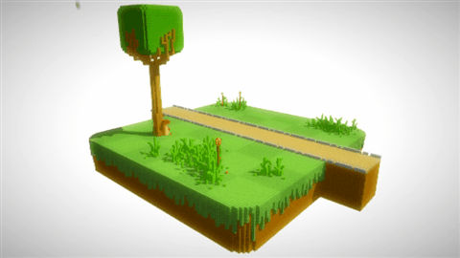
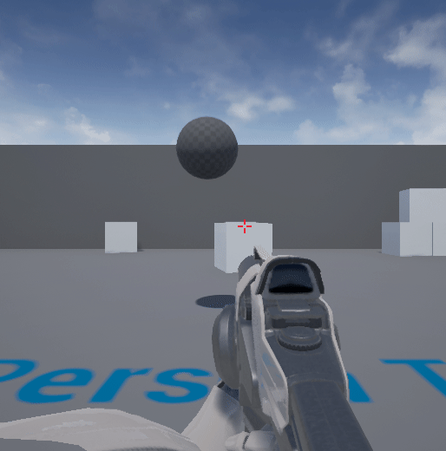
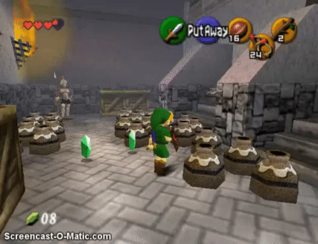
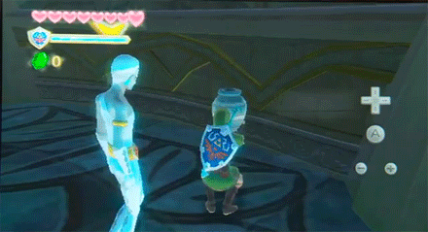
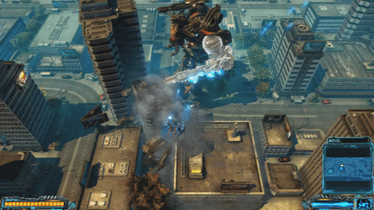
Increased Immersion in Videogames
(Luke)
Unreal Engine
Voxel-based Destruction
Simple Animation
Complex Animation, Voronoi Shattering, etc.
Online play, increased realism through nuanced elements: Destructible Meshes
1998
Improved, aesthetics, better controls
Present
Notes:
https://www.youtube.com/watch?v=mtUdICuMFXY
https://www.youtube.com/watch?v=TBmi9m3wo9o
https://thumbs.gfycat.com/YellowEcstaticCoyote-size_restricted.gif
https://www.youtube.com/watch?v=fy7PPVQXbi4
https://youtu.be/-gGiEmYj4oE?t=68
https://youtu.be/l0HT1dDES_4?t=25
https://www.youtube.com/watch?v=ktVmLJ5i4NY
http://i.imgur.com/YgyDmZ6.gif
https://www.google.com/search?q=destructible+mesh+gif&rlz=1C1GCEU_enUS820US820&tbm=isch&source=iu&ictx=1&fir=0NcME0dV52N98M%253A%252CC5gAFvSMT0qxSM%252C_&vet=1&usg=AI4_-kQ6BVtIyUggGJtgknJeQc0brvg2WA&sa=X&ved=2ahUKEwj68KT1hP7gAhWOtp4KHfcpBsoQ9QEwAXoECAUQBg&biw=893&bih=480&dpr=2.63#imgrc=0NcME0dV52N98M:

Slide 3
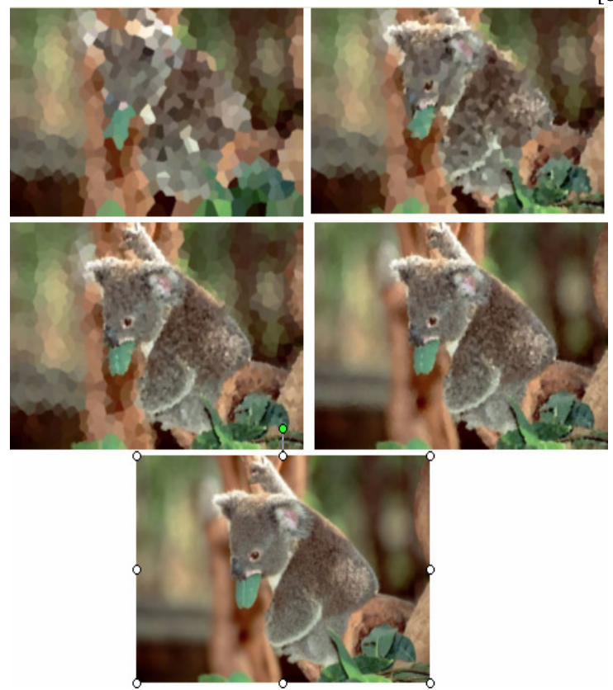
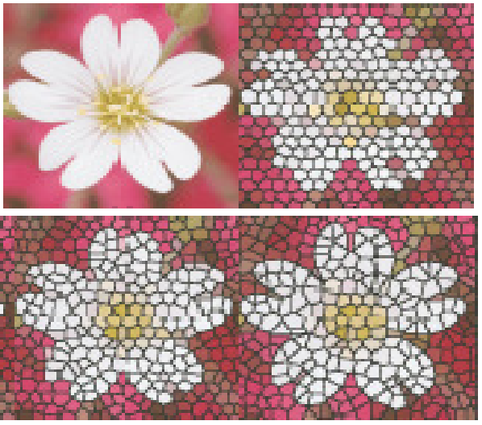
What is the Voronoi Algorithm (2D) – (Luke)
Partition set of points into individual Voronoi Cells
Each cell represents area closest to encapsulated point
Cells are convex
A few potential uses:
Reducing image data/image processing
Object mesh triangulation (Delaunay Triangulation)
Connect all cells sharing edge
Generally avoids “sliver triangles”
Mosaic Image Processing
Notes:
http://www.ams.org/featurecolumn/images/august2006/diagramintro.1.jpg
https://www.grasshopper3d.com/photo/delaunay-voronoi-tessellation?context=latest
http://mathworld.wolfram.com/images/eps-gif/DelaunayTriangulation_1000.gif
http://www.cs.cornell.edu/courses/cs100r/2007fa/lectures/100R-lec21.pdf
http://ece207.blogspot.com/2014/12/using-voronoi-diagrams-to-reduce-image.html
https://pdfs.semanticscholar.org/1685/9f8a09947be323ee978869c6a83fffe188b3.pdf

Slide 4
Applying Voronoi to create destructible meshes in 3D – (Tony)
Existing research into extending Voronoi to 3D mesh shattering
Volumetric Voronoi cells hold same properties as 2D cells
Triangulation to fill in missing sides of shattered meshes
Leveraged existing research
Figures from: “3D Voronoi Subdivision Tree for granular materials” - Matthew Clothier ; Mike Bailey
Notes:
https://ieeexplore.ieee.org/abstract/document/7395194

Slide 5
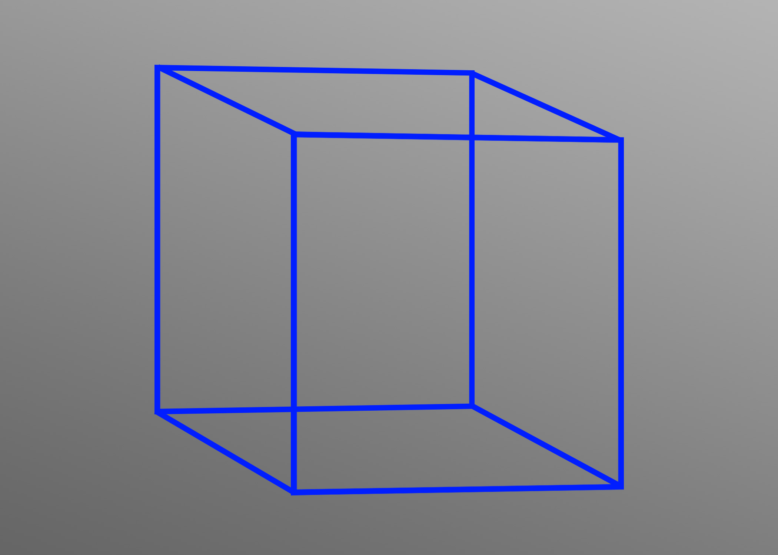

Slide 6
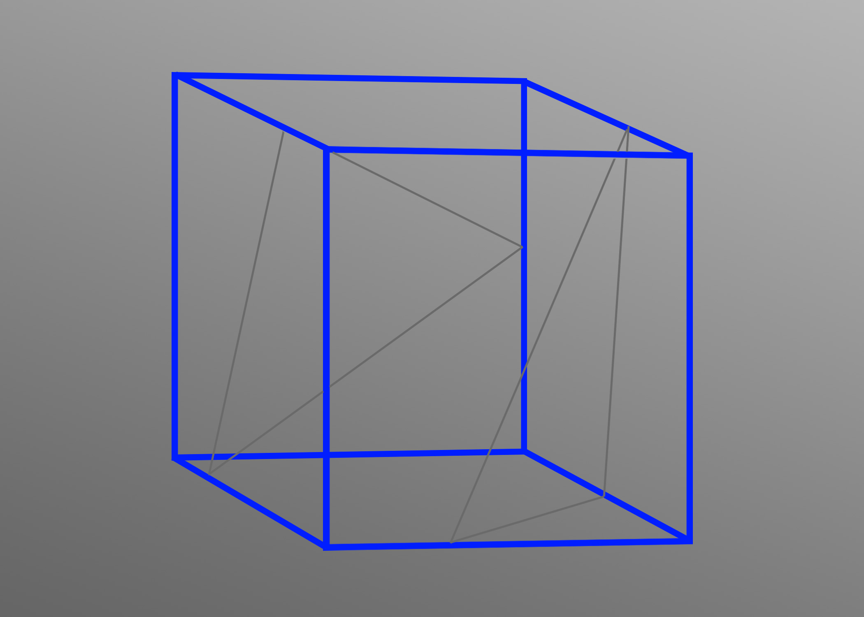

Slide 7
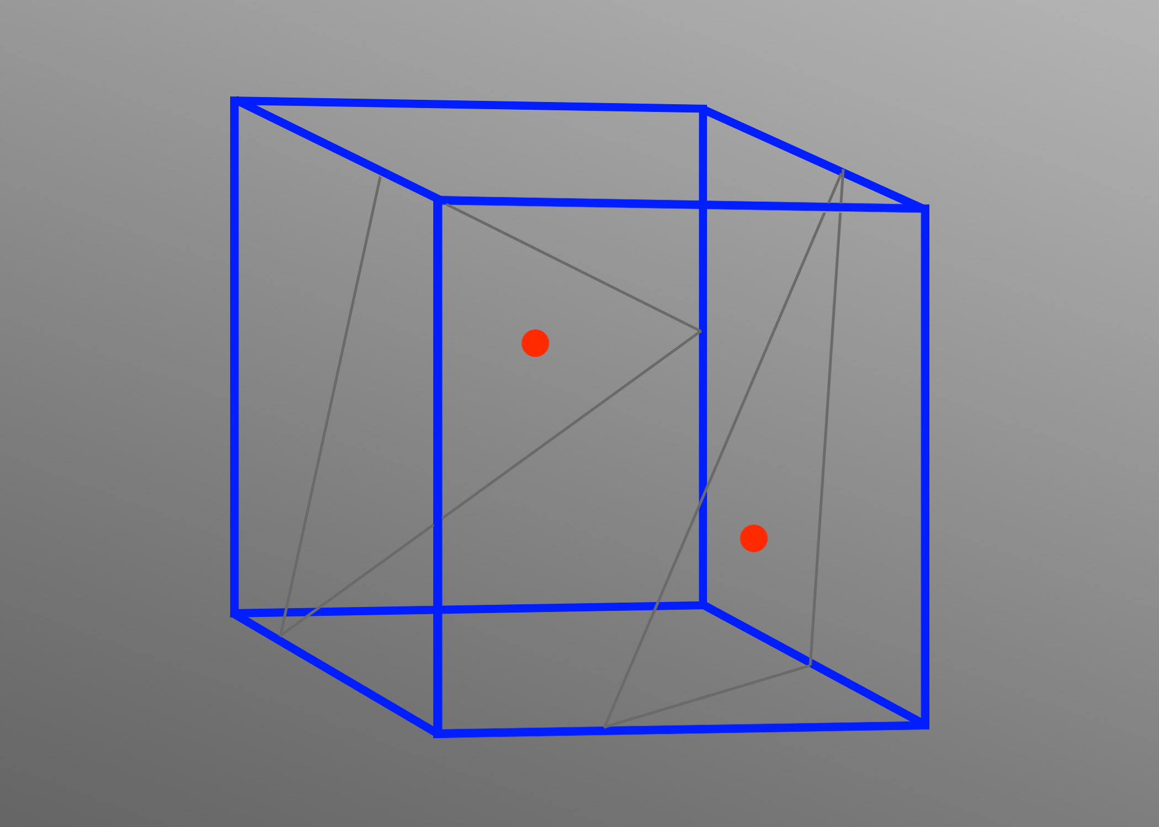

Slide 8


Slide 9


Slide 10
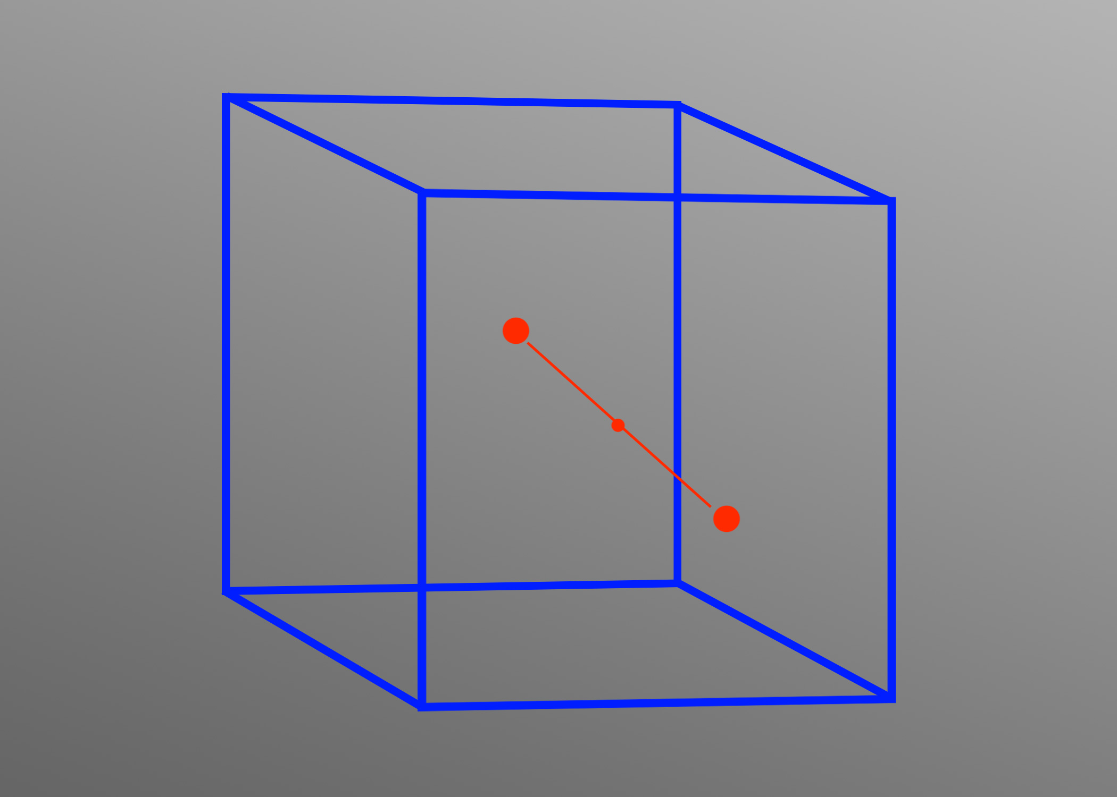

Slide 11


Slide 12
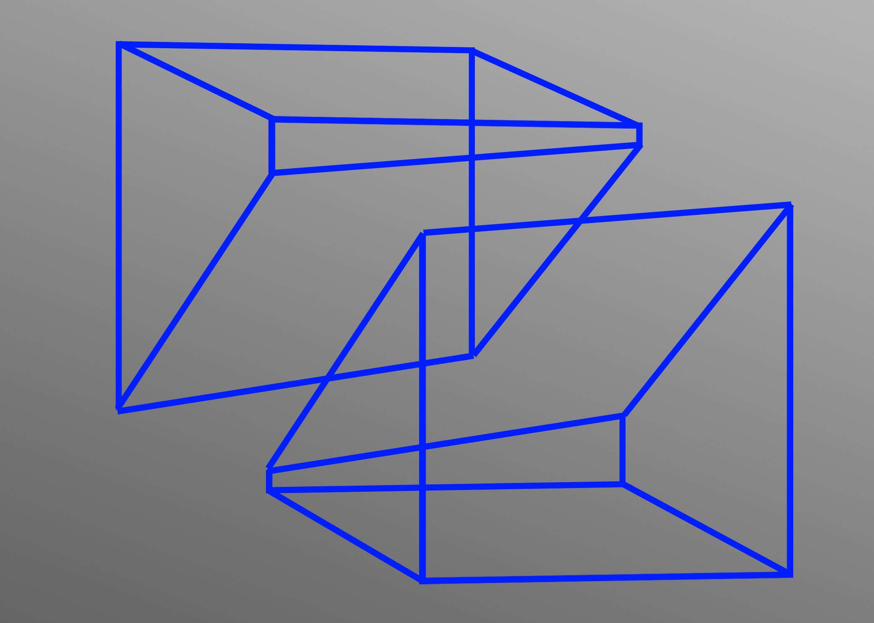

Slide 13
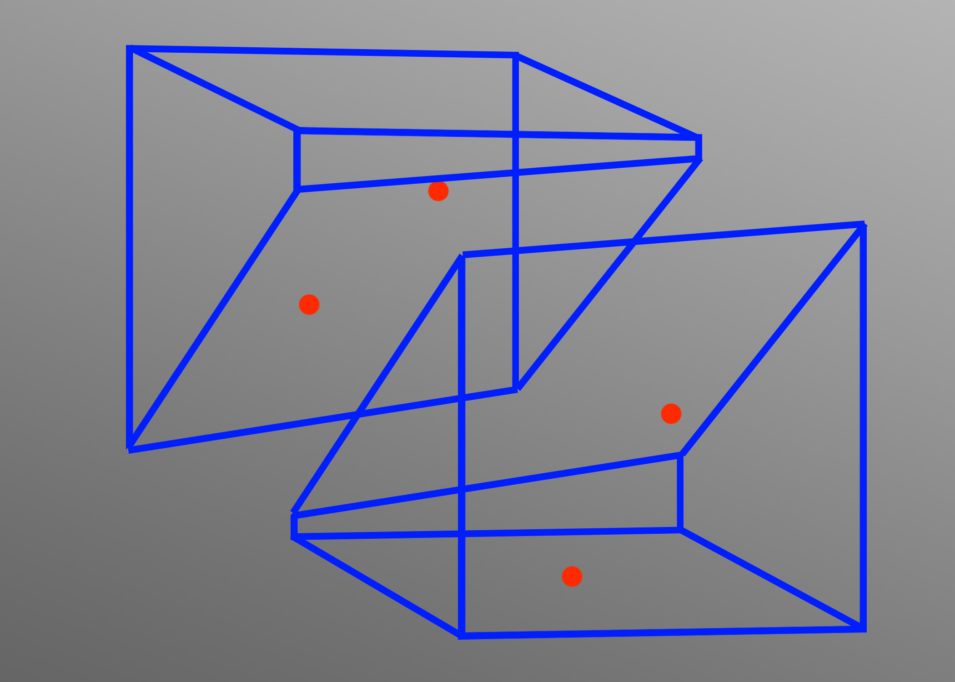

Slide 14
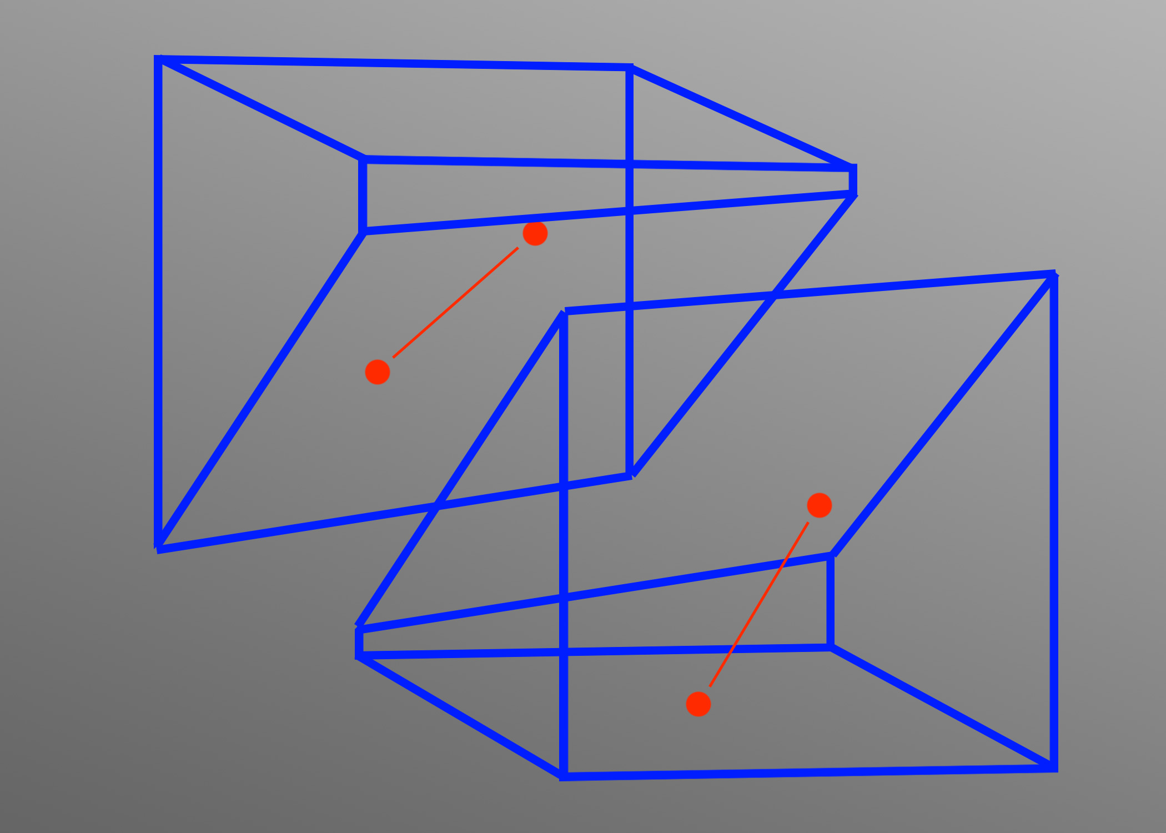

Slide 15


Slide 16
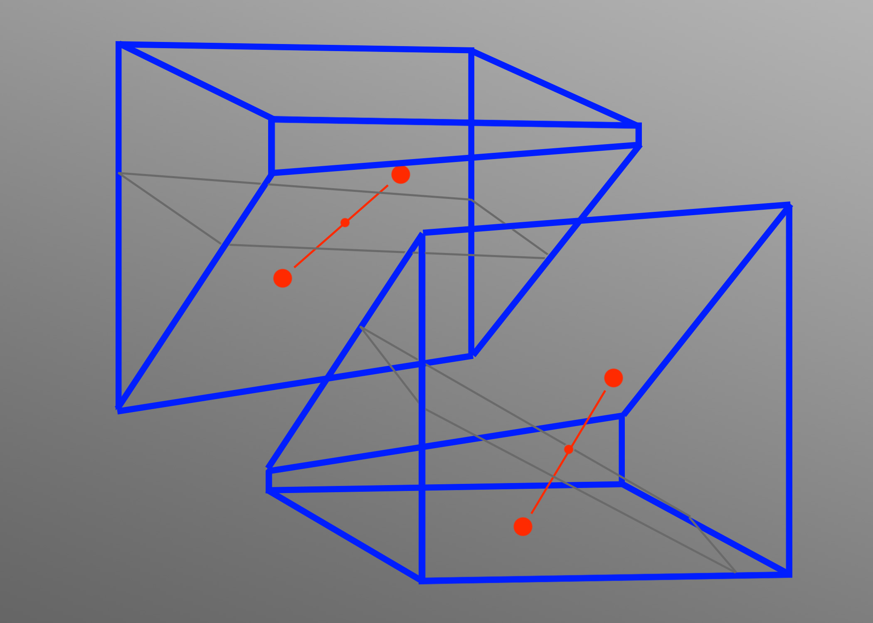

Slide 17
Demo – (Luke)

Slide 18
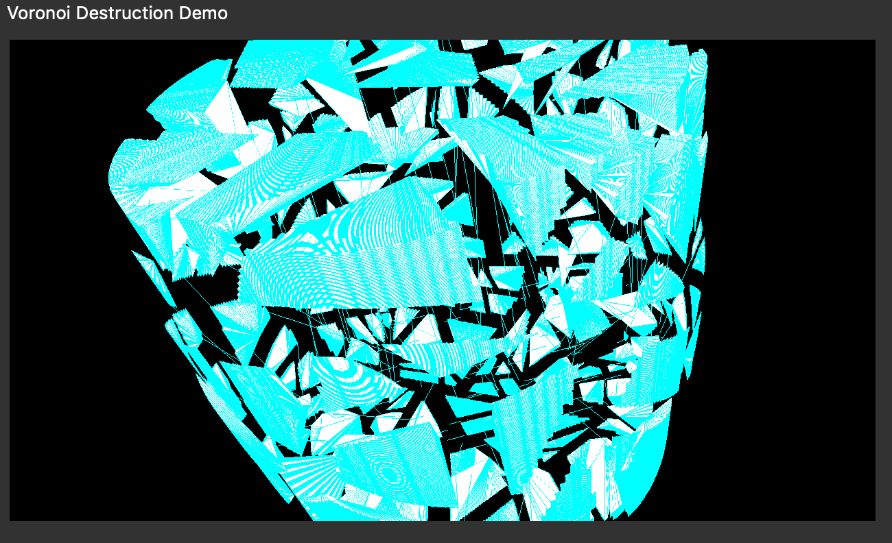
Learnings – (Tony)
Voronoi cell calculation complicates with >2 Voronoi vertices
Reliance on existing resolution/tessellation for vertices
Sometimes no internal triangulation
Challenges calculating triangles in high tessellation & large depth of splits
Number of plane-shape intersections
Voronoi implementation in 3D coupled with OpenGL is challenging (?)
Loss of volume in some shapes, additional points in some of the edge lines

